Slide 1
K-Nearest Neighbor Classifier
This approach requires proximity measure and a classification function that gives the predicted class based on the proximity
The class label of a test example is computed on the bases of its proximity to the data points in the training dataset
The K-Nearest Neighbors are chosen for this purpose

Slide 2
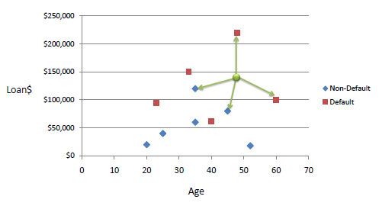
The K-Nearest Neighbor Example
Consider the following data concerning credit default. Age and Loan are two numerical variables (predictors) and Default is the target.

Slide 3
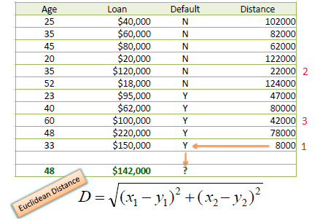
The K-Nearest Neighbor Example
We can now use the training set to classify an unknown case (Age=48 and Loan=$142,000) using Euclidean distance. If K=1 then the nearest neighbor is the last case in the training set with Default=Y.
D = Sqrt[(48-33)^2 + (142000-150000)^2] = 8000.01 >> Default=Y

Slide 4
The K-Nearest Neighbor Example
With K=3, there are two Default=Y and one Default=N out of three closest neighbors. The prediction for the unknown case is again Default=Y.

Slide 5
Pros and Cons
Pros:
Simple to implement
Naturally handles multi-class cases
Can do well in practice with enough representative data
Cons:
Large search problem to find nearest neighbors
We should know the distance measure

